Slide 1
Power Enjoy Project
Team:
Marco FERNI
Angelo Claudio RE
Gabriele TERMIGNONE

Slide 2
Overview
Domain
Assumptions
Goals
Scenarios
Use case diagram
Class diagram
Alloy example
High level architecture / deployment diagram
Component diagram
User interface
Subsystems integration sequence
Central server integration sequence
Function points estimation + effort an duration
Schedule
Risk

Slide 3
Domain
We are to develop a digital management system for a car-sharing service that exclusively employs electric cars

Slide 4
Required functionalities (1/2)
Users must be able to register to the system by providing their credentials and payment information. They receive back a password that can be used to access the system.
Registered users must be able to find the locations of available cars within a certain distance from their current location or from a specified address.
Among the available cars in a certain geographical region, users must be able to reserve a single car for up to one hour before they pick it up.
If a car is not picked-up within one hour from the reservation, the system tags the car as available again, and the reservation expires; the user pays a fee of 1 €.
A user that reaches a reserved car must be able to tell the system she's nearby, so the system unlocks the car and the user may enter.
As soon as the engine ignites, the system starts charging the user for a given amount of money per minute; the user is notified of the current charges through a screen on the car.
The system stops charging the user as soon as the car is parked in a safe area and the user exits the car; at this point, the system locks the car automatically.

Slide 5
Required functionalities (2/2)
The set of safe areas for parking cars is pre-defined by the management system.
If the system detects the user took at least two other passengers onto the car, the system applies a discount of 10% on the last ride.
If a car is left with no more than 50% of the battery empty, the system applies a discount of 20% on the last ride.
If a car is left at special parking areas where they can be recharged and the user takes care of plugging the car into the power grid, the system applies a discount of 30% on the last ride.
If a car is left at more than 3 KM from the nearest power grid station or with more than 80% of the battery empty, the system charges 30% more on the last ride to compensate for the cost required to re-charge the car on-site.
If the user enables the money saving option, he/she can input his/her final destination and the system provides information about the station where to leave the car to get a discount. This station is determined to ensure a uniform distribution of cars in the city and depends both on the destination of the user and on the availability of power plugs at the selected station.

Slide 6
Assumptions

Slide 7
Definitions
Cost of the trip: is the raw price of the service calculated only on the base of the duration of the car's usage, before discounts or additional charges are applied.
Virtuousness coefficient: is the factor by which to multiply the cost of the trip to get the amount of the bill. Its initial value is 1.
Supervisor: is a company employee who work at the Car hub controller.
Recharge on site: is a company procedure: a worker is sent to recharge a low car that was parked detached from the power grid.
Car recovery: is a company procedure: a worker is sent to retrieve a car that has been forgotten outside a safe area and park in one of these.
Guest: is a person who is not already registered to the system.
User: is a registered customer.

Slide 8
Domain assumptions (1/2)
The only payment methods accepted are credit cards (not prepaid).
The system continues counting the minutes of usage while the car is outside the safe areas, also if it's turned off.
A user uses a car only if the power remaining in the car's battery is sufficient for his trip.
There is a CAR HUB CONTROLLER where a supervisor can monitor the status of every car and dispatch the recharge on site if a car is left with less than 20% battery life remaining and it isn't connected to a power grid. The supervisor is also responsible to dispatch the car recovery responsible for when a car is left outside a safe area for more than 5 hours.
The cars can be recharged by the users only in the special parking areas with power grid.
Special parking areas with power grid are a subset of the predefined set of the safe areas.
When a user get into a car, he actually starts using it.

Slide 9
Domain assumptions (2/2)
A user finishes using the car when he leaves the car in a safe area.
Users are not permitted to delete a reservation.
When users get in or exit a car, they close the car's door.
Users do not leave the car without turning it off.
The passengers counted to obtain the 10% discount are them who are present in the car at the time of the first ignition.
The screens on the car show the same infos showed on the myReservation page of the users' app (duration of the trip, current cost of the trip), and a map with the suggested route to take (if the user selected the money saving option).

Slide 10
Goals

Slide 11
Goals (1/2)
G1: Ensure system’s accessibility
G2: Supervisors must be able to check cars’ status
G3: Supervisor should be able to dispatch ”recharge on site” correctly
G4: Supervisor should be able to dispatch ”car recovery” correctly
G5: Guarantee the correctness of each car’s ”availability state”
G6: Allow user to find available cars within a certain distance from a specified place

Slide 12
Goals (2/2)
G7: Allow user to reserve a single car
G8: Discourage fake and too long reservation
G9: Allow the user who reserved the car to see information about his reservation
G10: Allow only the user who reserved the car (and his passenger) to access it
G11: Guarantee the correctness of the ”cost of the trip”
G12: Guarantee the correctness of the ”virtuousness coefficient”
G13: Guarantee the correctness and the payment of the final bill
G14: Support the users saving money

Slide 13
Scenarios

Slide 14
Scenarios
We identified 5 possibile scenarios:
“Deal with the strike”: when a public transport strike forces us to find an alternative way for our travel.
“Friends in saving”: choosing a cheap way when no others budget-friendly choices are available.
“A busy businessman”: what happens when you reserve a car but don’t pick it up?
“Desperate housewife”: and what about people who weight more comfort than saving.
“A Long Road”: a typical shopping day and all of its implications.

Slide 15
Use Case Diagram

Slide 16
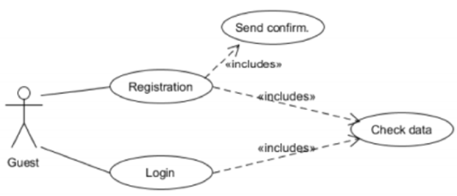
Use Case (1/3)

Slide 17
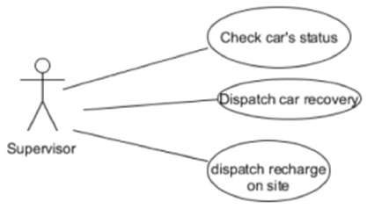
Use Case (2/3)

Slide 18
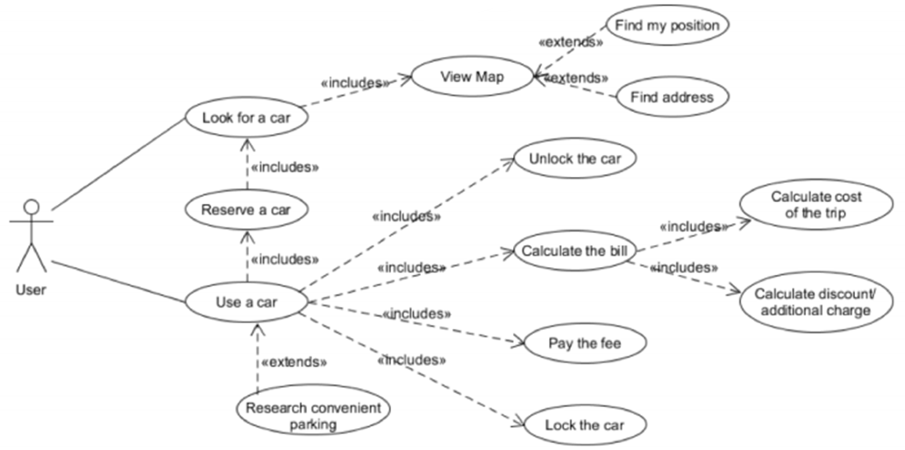
Use Case (3/3)

Slide 19
Class Diagram

Slide 20
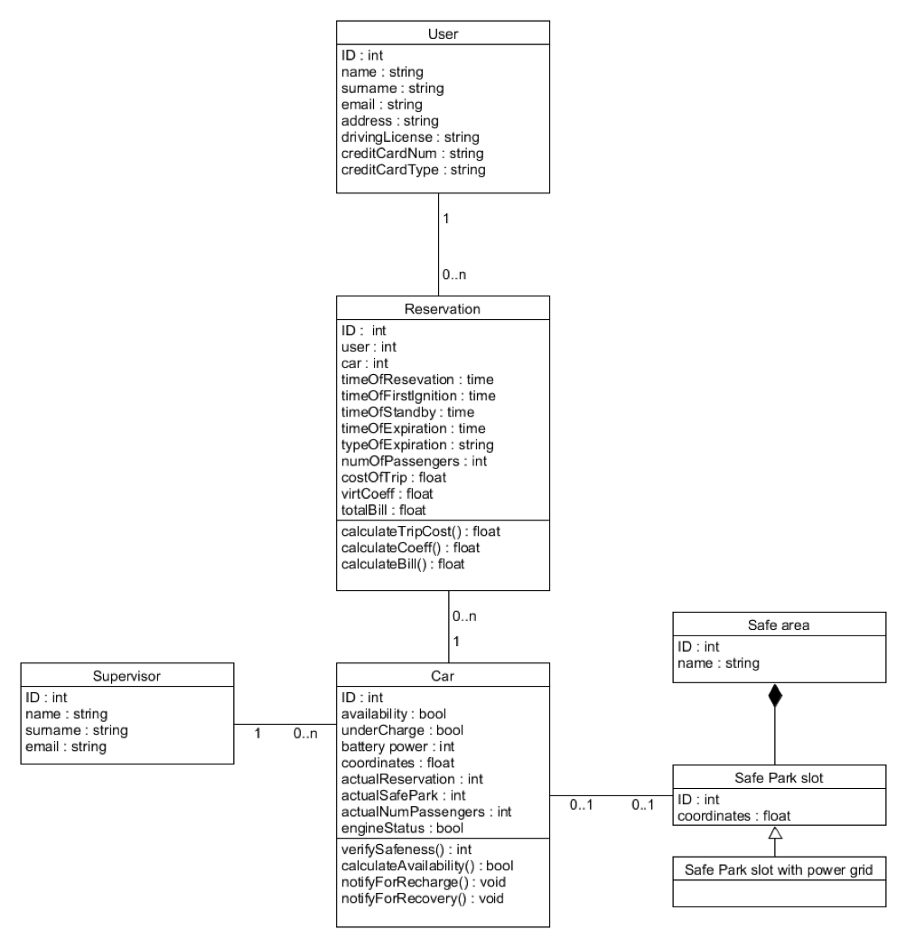

Slide 21
Alloy example

Slide 22
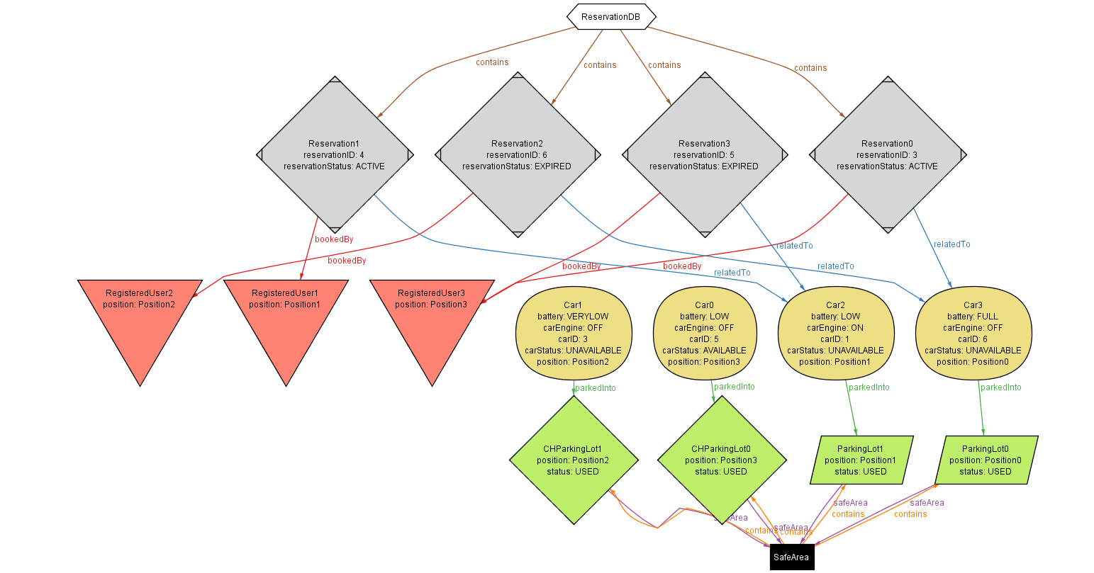

Slide 23
High level architecture / deployment diagram

Slide 24
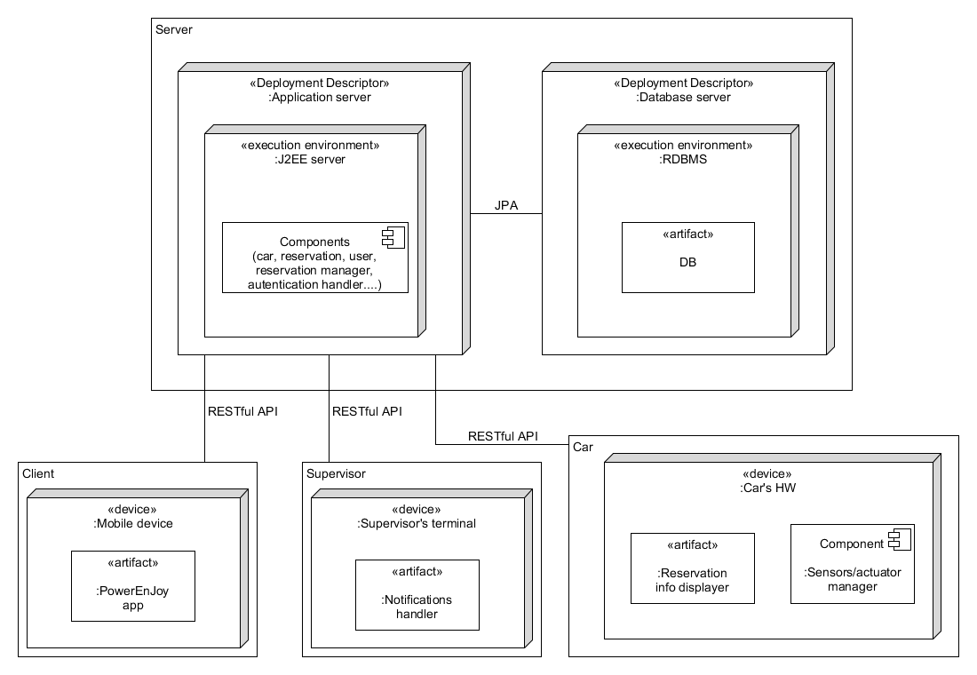
High Level Architecture view
3 tiers architecture
Server Implemented using JEE
Application server: GlassFish
DBMS: MySQL
Access to the DB through JPA
Communication through RESTful APIs

Slide 25
Component diagram

Slide 26
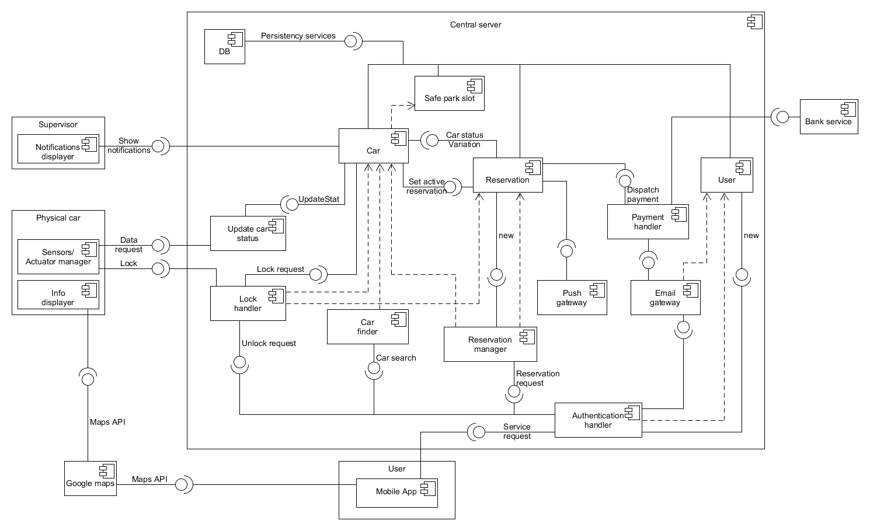

Component Diagram
Maps API

Slide 27
User interface

Slide 28
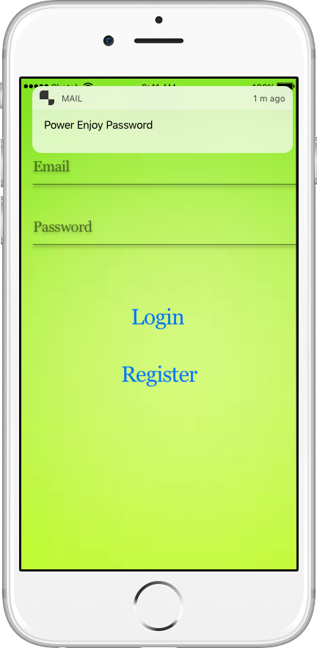
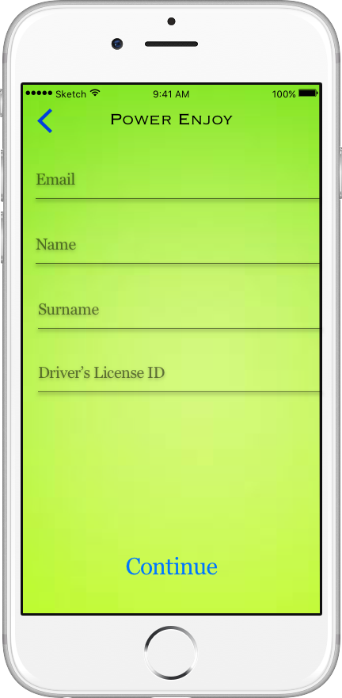
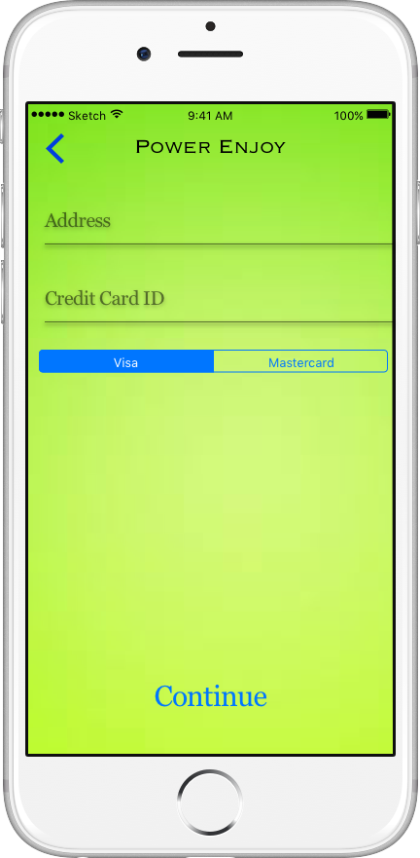
User interaction
Login and Sign-up interface

Slide 29
User interaction
Login and Sign-up components involved
Maps API

Slide 30
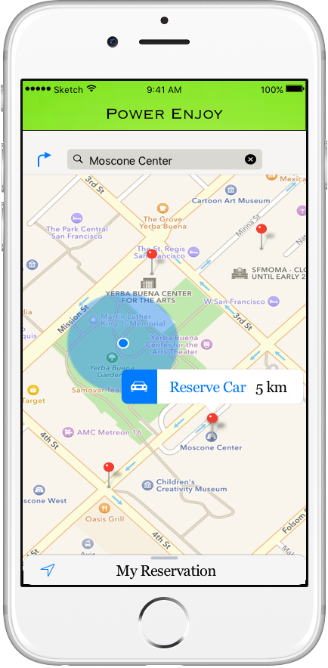
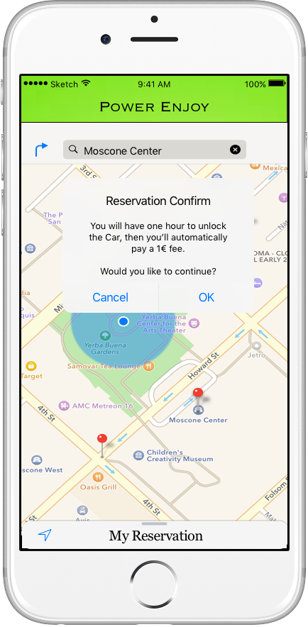
User interaction
Reserve a car interface

Slide 31
User interaction
Reserve a car components involved
Maps API

Slide 32
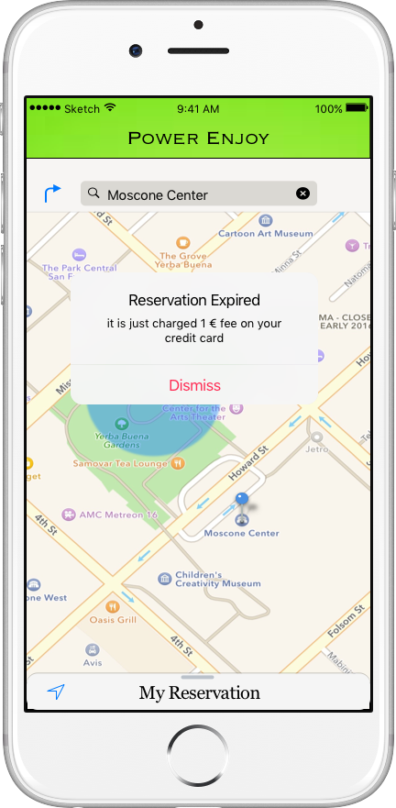
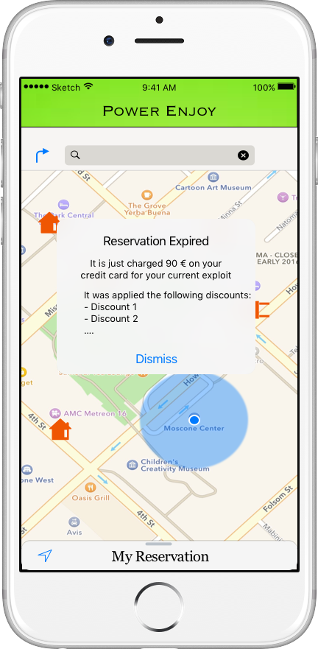
User interaction
Reservation Expired interface

Slide 33
User interaction
Reservation Expired components involved
Maps API

Slide 34
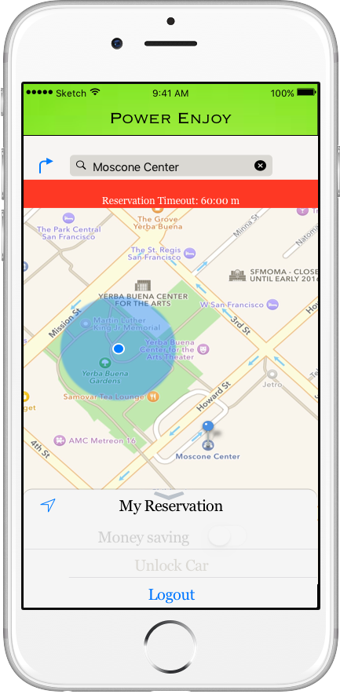
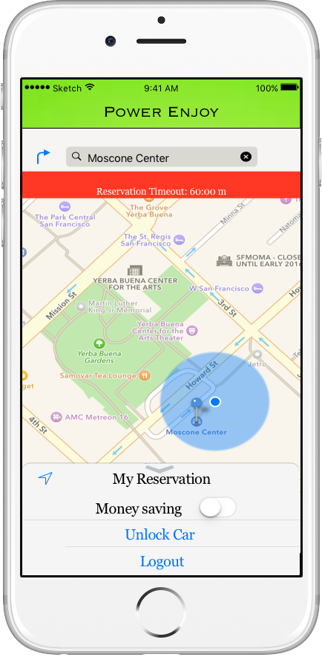
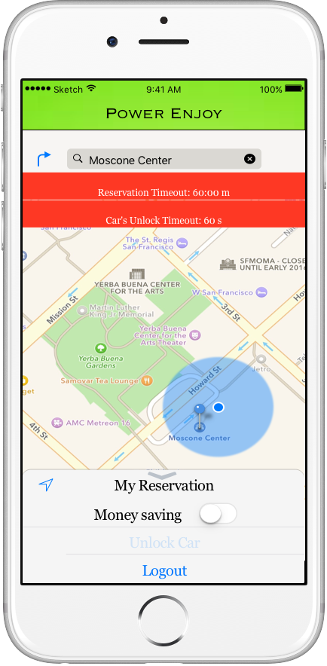
User interaction
Reach and unlock the car interface

Slide 35
User interaction
Reach and unlock the car components involved
Maps API

Slide 36
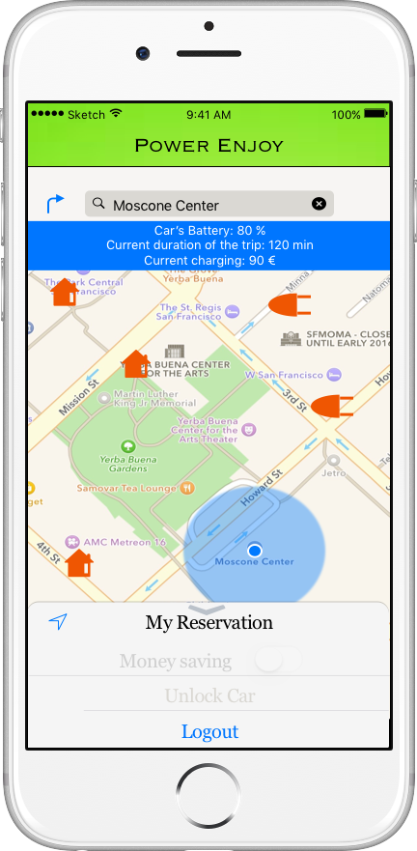
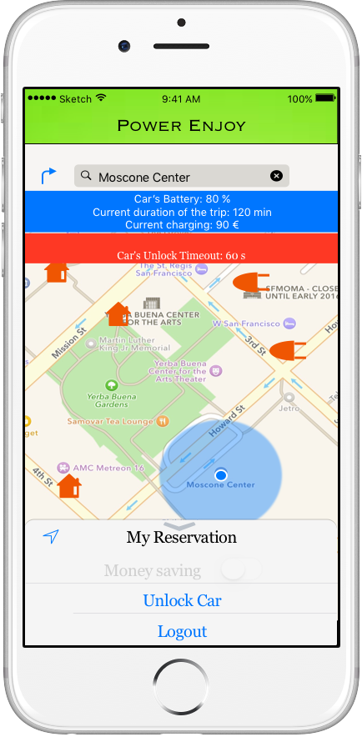
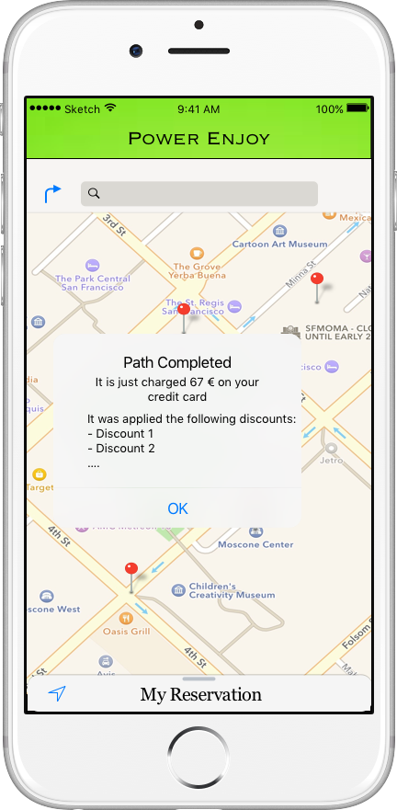
User interaction
Trip interface (1/2)

Slide 37
User interaction
Trip components involved
Maps API

Slide 38
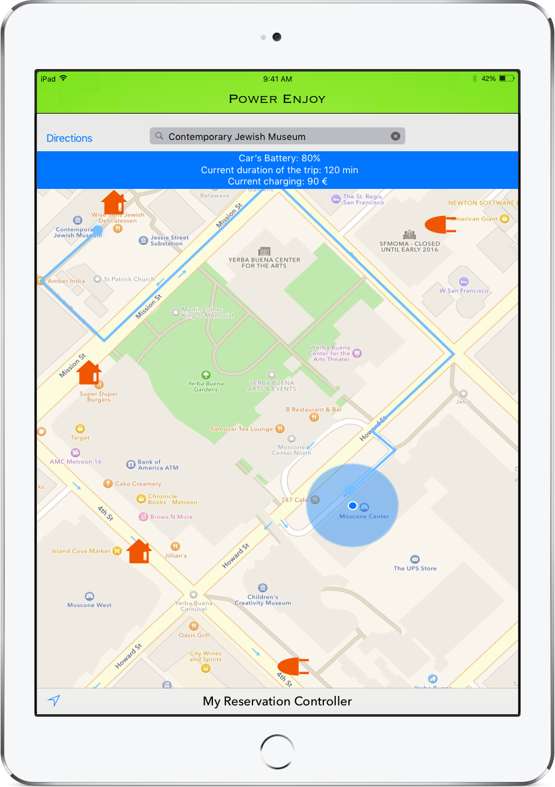
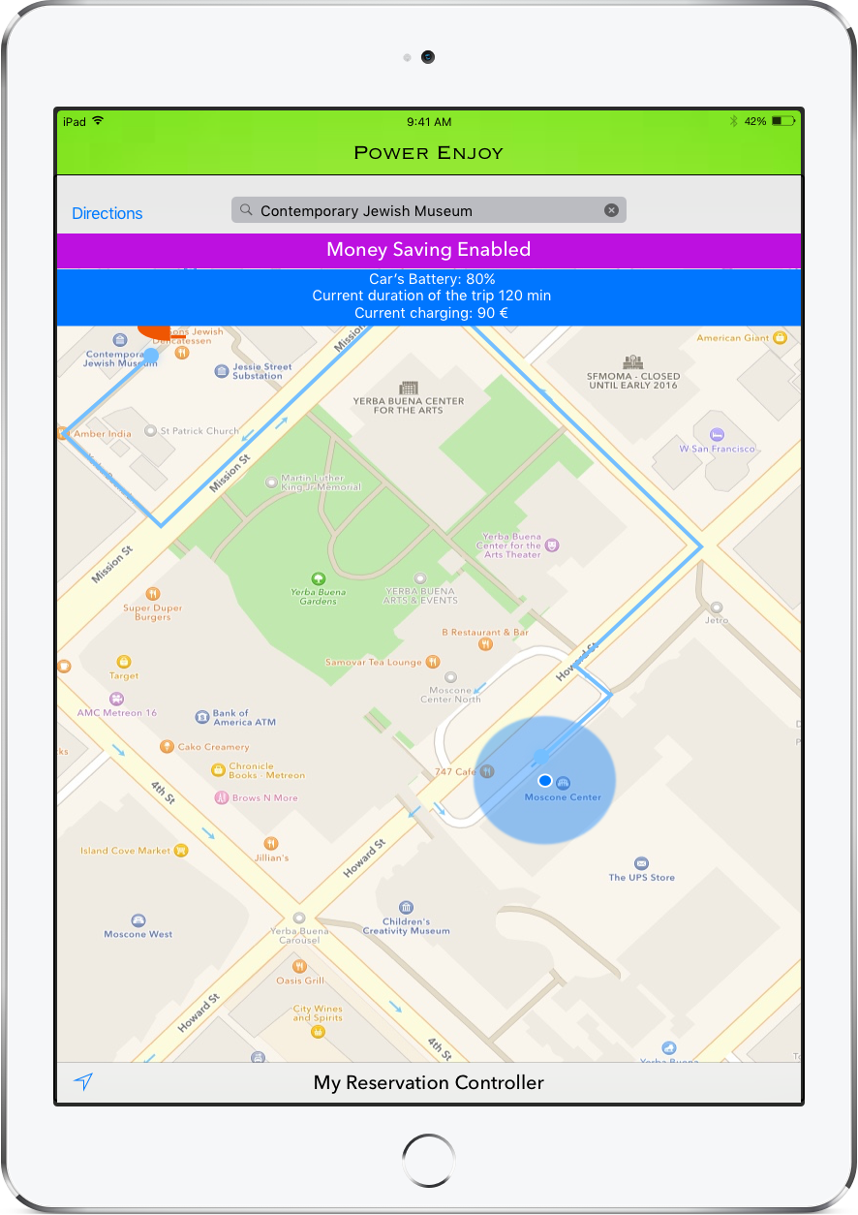
Car interaction
Trip interface (2/2)

Slide 39
Car interaction
Trip components involved
Maps API

Slide 40
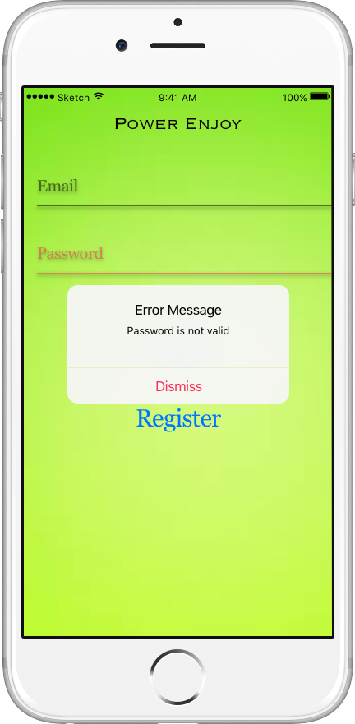
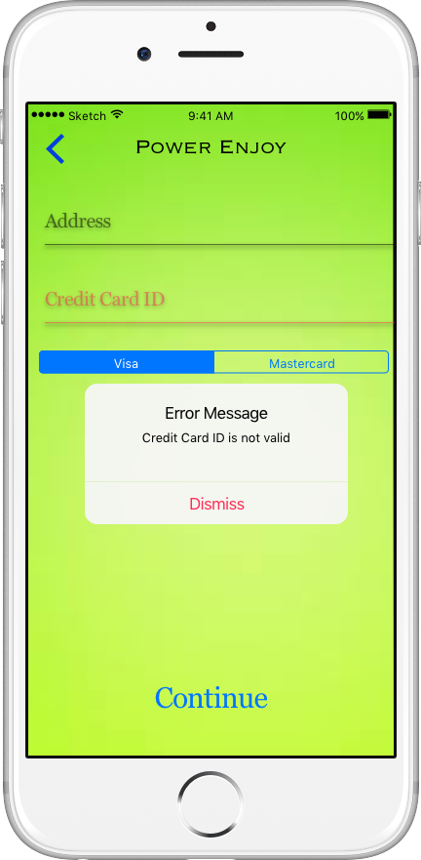
User interaction
Error handlers interface

Slide 41
User interaction
Error handlers components involved
Maps API

Slide 42
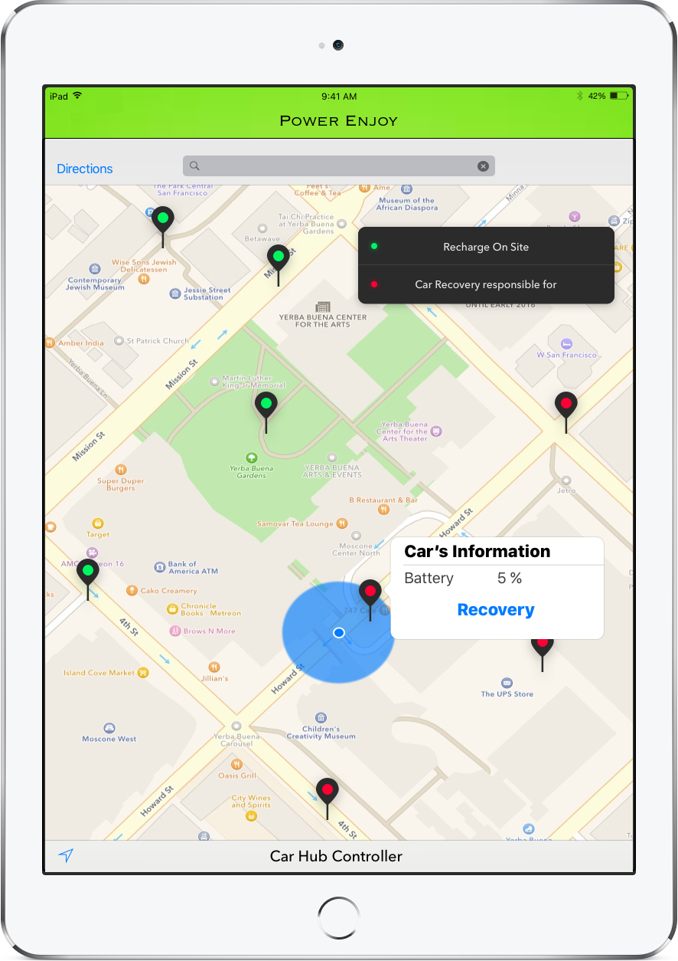
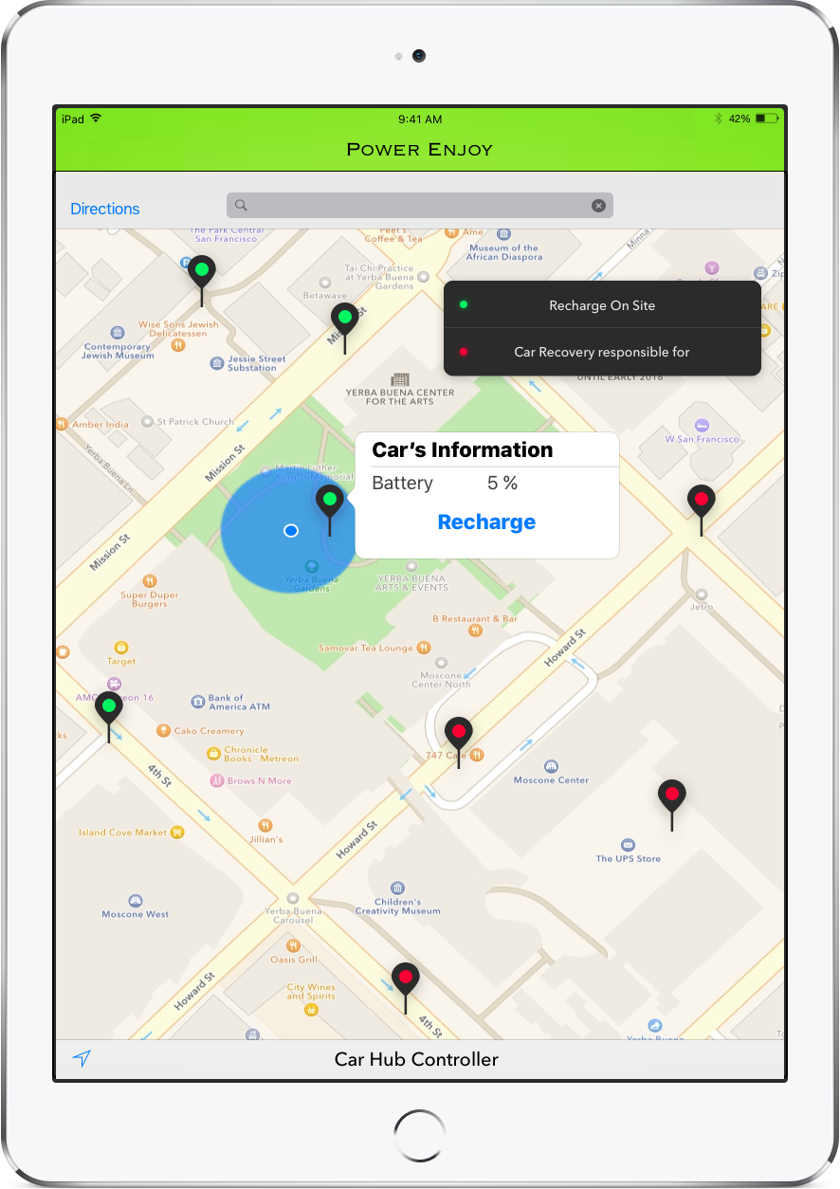
Supervisor interaction

Slide 43
Supervisor interaction
components involved
Maps API

Slide 44
Central server integration sequence

Slide 45
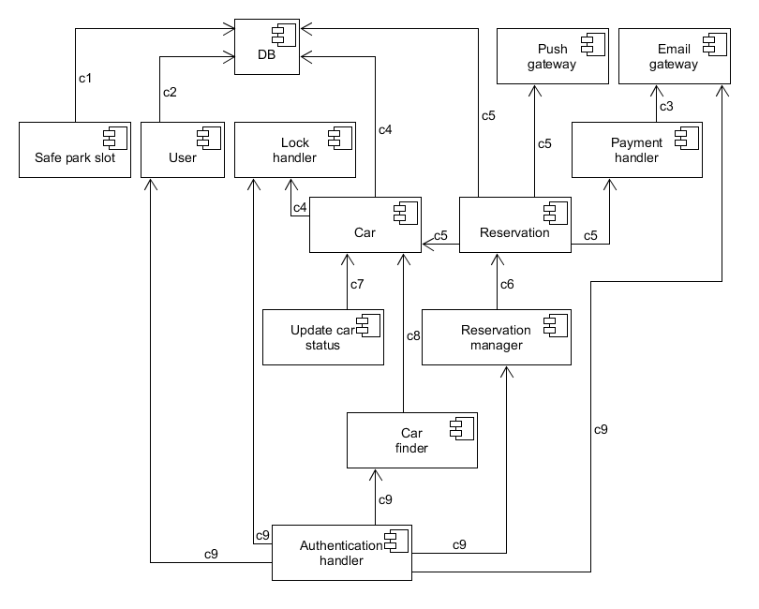
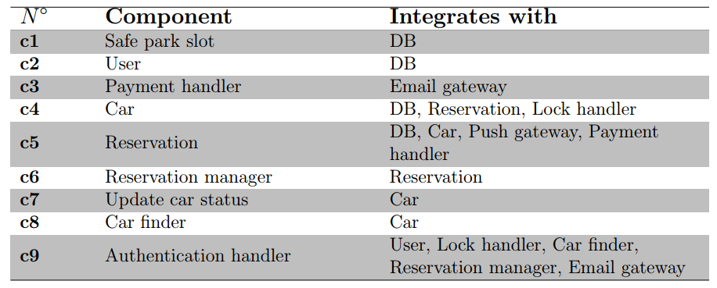
Components Integration
Each component unit tested
Bottom-up approach
Usage of simple drivers
Usage of stub to test the interactions between car and reservsation

Slide 46
Subsystem integration sequence

Slide 47
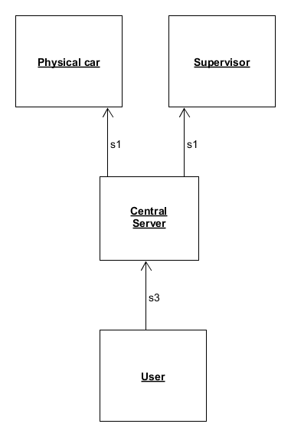
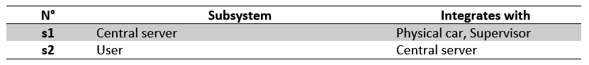
Subsystems Integration
Bottom-up approach
Usage of simple drivers
Central server needed to test the mobile app

Slide 48
Function points estimation
+ effort and duration

Slide 49
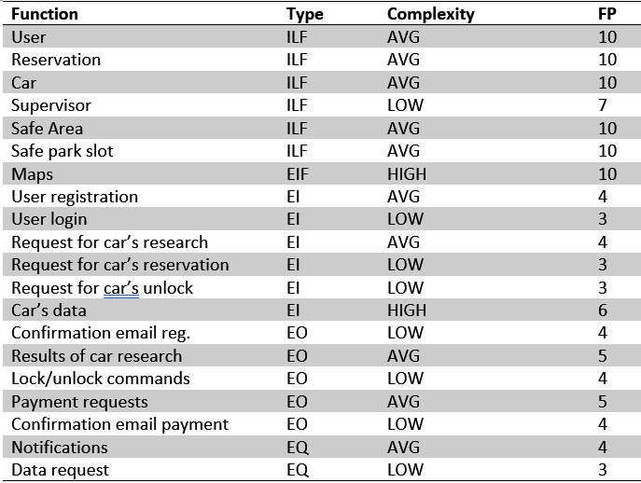
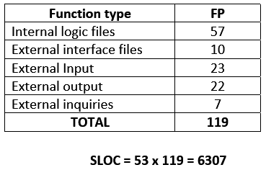
Function Points Estimation

Slide 50
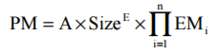
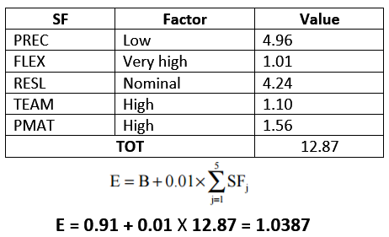
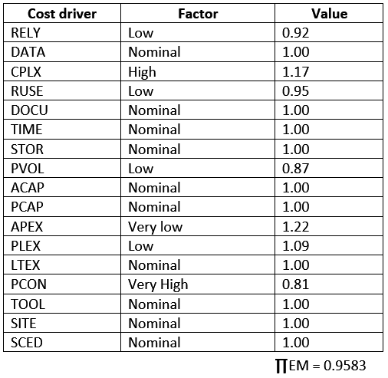
Effort Estimation
Scale Factors:
Cost Driver:

Slide 51
Schedule

Slide 52
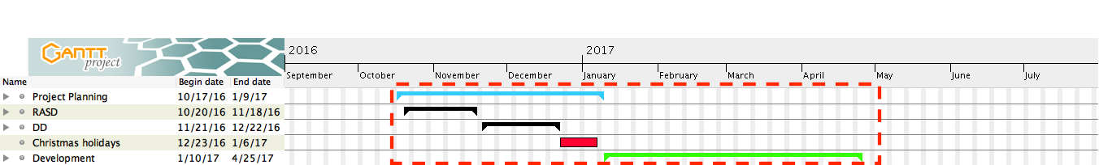
Schedule (1/6) – General Overview

Slide 53
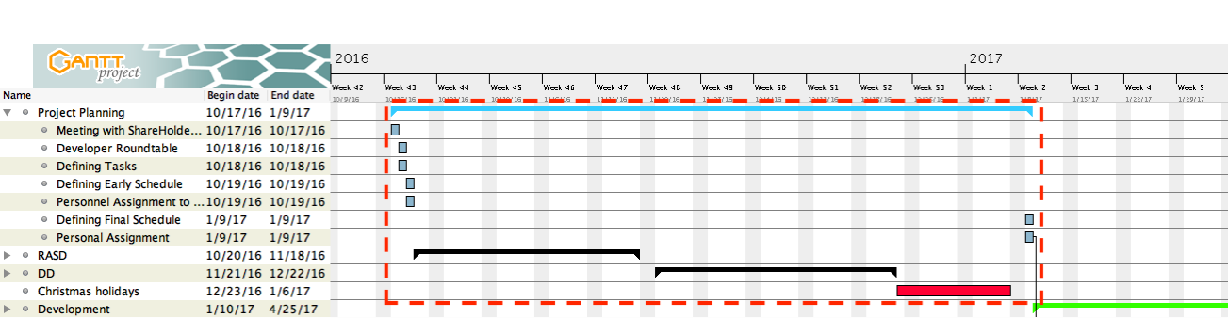
Schedule (2/6) – Project Planning

Slide 54
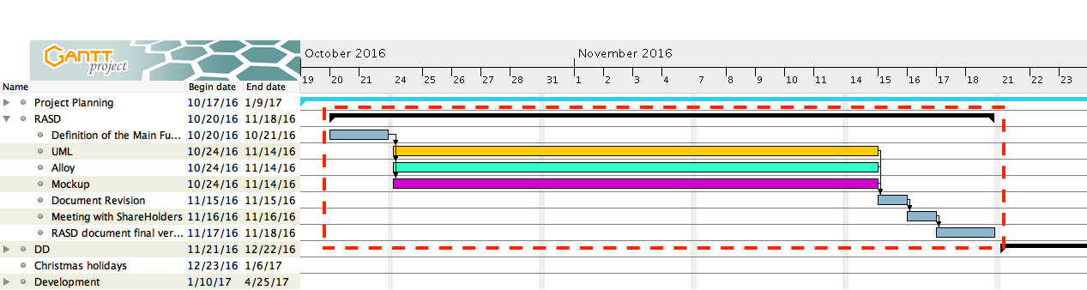
Schedule (3/6) – Requirements & Specifications

Slide 55
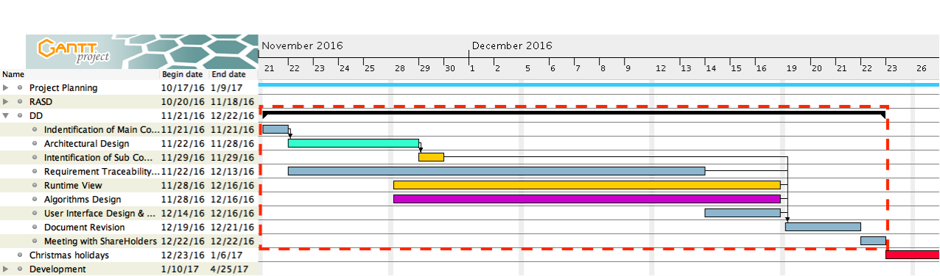
Schedule (4/6) – Design

Slide 56
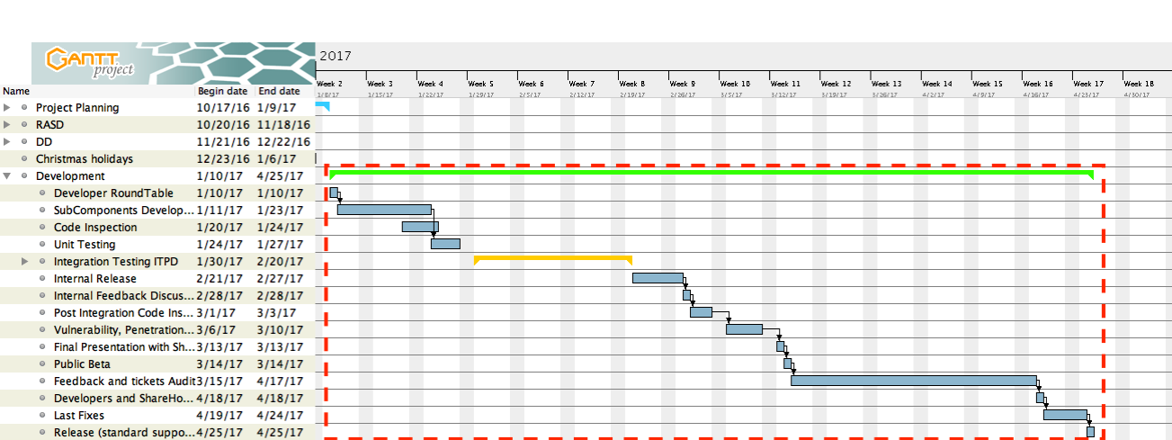
Schedule (5/6) – Development

Slide 57
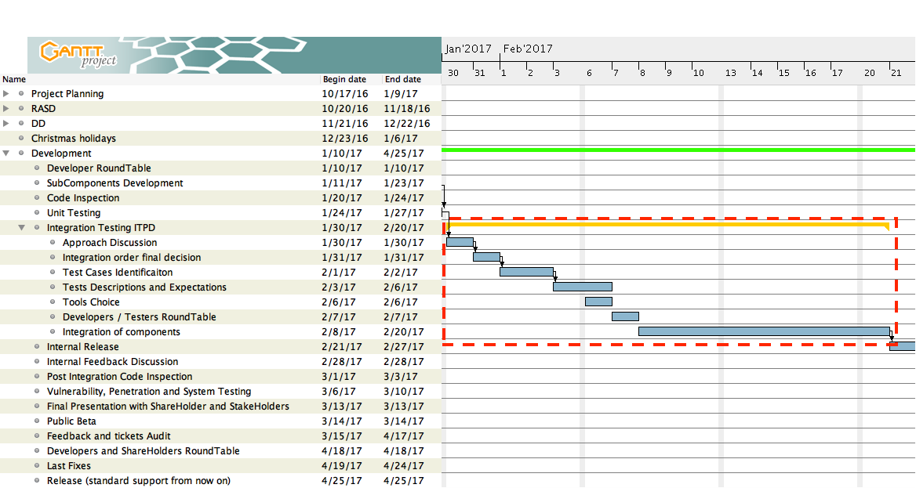
Schedule (6/6) – Integration Testing

Slide 58
Risk

Slide 59
Risk Factors
In this section we're going to assess the main risks that the project development may face.
We adopted a proactive risk strategy and detected the following risks divided in 3 main category.
Project Risks
Technical Risks
Business Risks

Slide 60
Project Risks
RISK01 [requirements volatility]: requirements are changed by the committee.
RISK02 [Unrealistic schedule/budget]: Estimates may be unrealistic with respect to the requirements.
RISK03 [Wrong functionality]: May have a variety of causes, such as an imperfect understanding of the customer needs, the complexity of communication with the client, insufficient domain knowledge of the developers and designers.
RISK04 [Bad external components]: The quality or functionality of externally supplied components may be below what is required for this project (e.g. google maps service or payment interface unavailable).
RISK05: Key staff are ill at critical times in the project.
RISK06: The size of the software is underestimated.
RISK07: The time required to develop the software is underestimated.

Slide 61
Technical Risks
RISK08 [Real-time shortfalls]: The real-time performance of (parts of) the system may be inadequate (users requests to application server).
RISK09 [Wrong user interface]: In certain situations, the user-friendliness of the interface is critical to its success.
RISK10 [Gold plating]: Developers may wish to develop features not asked for by the customer.
RISK11 [the database used in the system cannot process as many transactions per second as expected.
RISK12: The rate of defect repair is underestimated.

Slide 62
Business Risks
RISK13 [too few clients]: the sales force did not find enough customers for the product.
RISK14 [competitors]: others companies can develop a similar product, reducing our market opportunities.

Slide 63
Contingency Plan
RISK01: Derive traceability information to assess requirements change impact; maximize information hiding in the design.
RISK02: Investigate buying-in components.
RISK03: Involve the stakeholders in the requirements and design phase with surveys
RISK05: Reorganize team so that there is more overlap of work and people therefore understand each other's jobs.
RISK06: investigate use of a program generator.
RISK07: Investigate buying-in components; investigate use of a program generator.
RISK08: Overrate application servers resources, or investigate the possibility of buying a higher-performance application server or move the system to an highly scalable platform.
RISK09: Involve the stakeholders with discussions on the interface design.
RISK10: Stakeholders have an active role in the development of the project, in the requirement analysis and design phases as well as in the implementation phase. Activities in this direction may include periodical reviews and meetings, demonstrations, discussions on the interface design and so on.
RISK11: Investigate the possibility of buying a higher-performance database or move the system to an highly scalable platform.
RISK12: Replace potentially defective components with bought-in components of known reliability.
RISK13/14: Promote our product using some advertising

Slide 64
Questions, doubts, Issues ???

